Slide 1
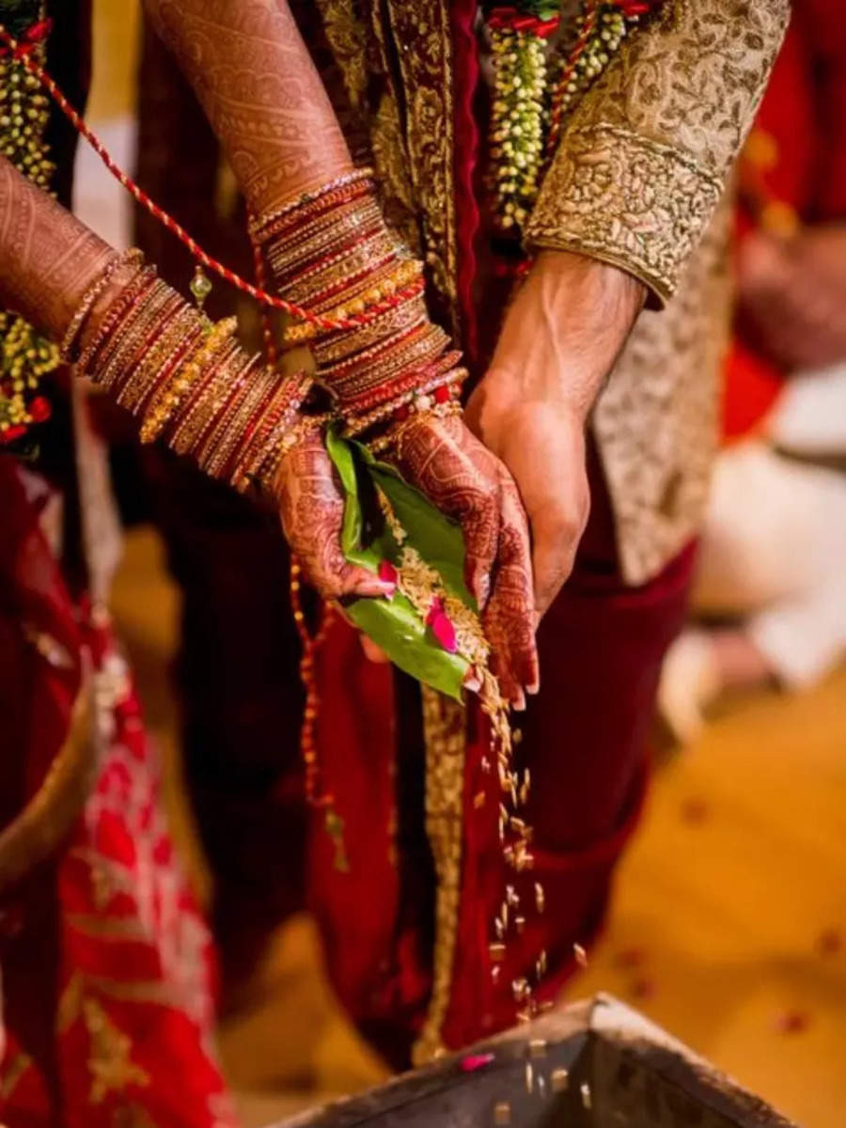

FAMILY AND MARRIAGE
Miss Shahtaj Shakir
Lecture: 7th
Sociology
FAST NUCES, Spring 2023

Slide 2
Learning outcomes
Understanding the concept of family and marriage in sociology
Explanation of these concepts through different theories

Slide 3

What is a

Slide 4

FAMILY
Burgess and Locke defined family as “a group of persons united by ties of marriage, blood or adoption constituting a single household interacting and intercommunicating with each other in their respective roles of husband and wife, father and mother, so and daughter, brother and sister, creating a common culture”.
A family consists of people who consider themselves related by blood, marriage, or adoption
Of all the human groups, family is the most important one.

Slide 5
TYPES OF FAMILIES
On the basis of structure
Nuclear Family: a family consisting of a husband, wife, and child(ren)
Extended Family: a family in which relatives, such as the “older generation "or unmarried aunts and uncles, live with the parents and their children
Joint family: joint family is a type of family in which two or more family live in one house.
Blended Family: A blended family, also known as a stepfamily, is a family formed when two people come together and bring a child or children from previous relationships. When a blended family is formed, your children might be of the same age group or have major age differences, and you might also have a child together.

Slide 6
TYPES OF FAMILIES
On the basis of Authority
Patriarchal- Male dominant ,female subordinate
Matriarchal-Female dominant, Males subordinate

Slide 7
TYPES OF FAMILIES
On the basis of Marriage
Monogamous- One man marry one woman
Polygamous- One man marry two or more women
Polyandrous-One woman marry two or more man

Slide 8
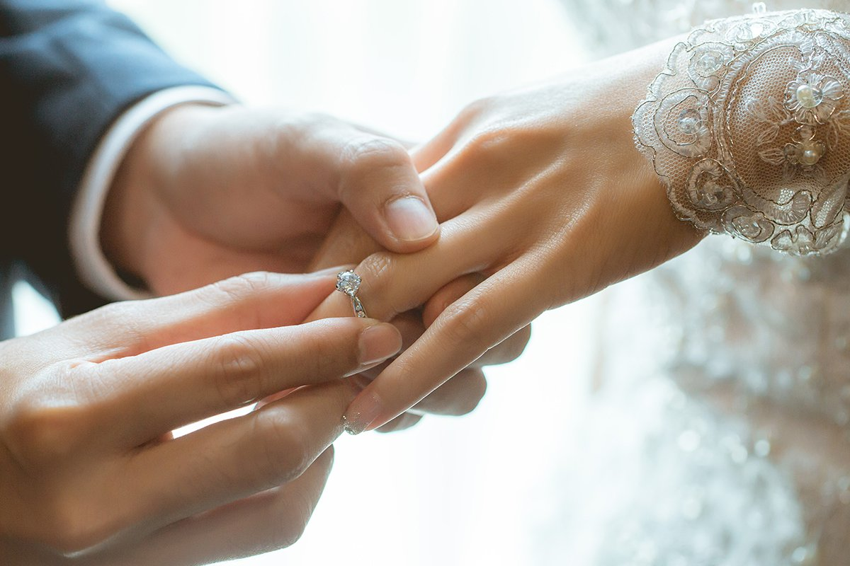
Marriage
Marriage is one of the universal social institution.
It is established by the human society to control and regulate the sex life of human.
It is closely connected with the institution of family.

Slide 9

Marriage
Definition:
There is no definition which adequately covers all types of marriage.
Malinowski :- “Contract for the production and maintenance of children”
Robert.H.Lowie:- “ Marriage is a relatively permanent bond between permissible mates”
Alfred McClung Lee :Marriage is the public joining together, under socially specified regulations of a man and woman as husband and wife”

Slide 10

Mate selection
Each human group establishes norms to govern who marries whom. If a group has norms of endogamy, it specifies that its members must marry within their group.
In contrast, norms of exogamy specify that people must marry outside their group.

Slide 11

Inheritance
Marriage and family are also used to determine rights of inheritance.
In a bilineal system, property is passed to both males and females; in a patrilineal system, only to males; and in a matrilineal system (the rarest form), only to females.
No system is natural. Rather, each matches a group’s ideas of justice and logic.

Slide 12

Marriage and Family in Theoretical Perspective
When functionalists look at marriage and family, they examine how they are related to other parts of society, especially the ways that marriage and family contribute to the well-being of society.

Slide 13
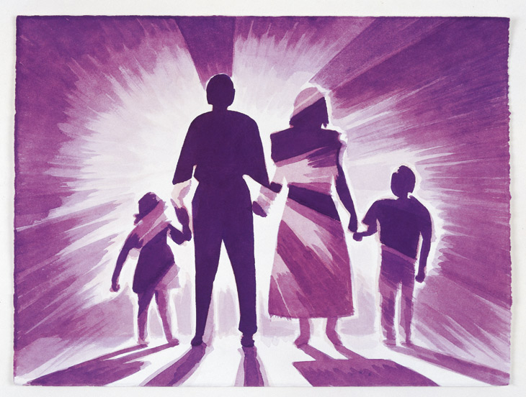
Why the Family Is Universal?
According to functionalists:
The family fulfills five needs that are basic to the survival of every society.
These needs, or functions:
(1) economic production,
(2) socialization of children,
(3) care of the sick and aged,
(4) sexual control, and
(5) reproduction.
To make certain that these functions are performed, every human group has adopted some form of the family.

Slide 14
Isolation and Emotional Overload
The relative isolation of today’s nuclear family creates one of those dysfunctions. Because the members of extended families are embedded in a larger kinship network, they can count on many people for material and emotional support. In nuclear families, in contrast, the stresses that come with crises—the loss of a job, a death, or even family quarrels—are spread among fewer people. This places greater strain on each family member, creating emotional overload.

Slide 15
The Conflict Perspective: Struggles between Husbands and Wives
Anyone who has been married or who has seen a marriage from the inside knows that despite a couple’s best intentions, conflict is a part of marriage. Conflict inevitably arises between two people who live intimately and who share most everything in life—from their goals and checkbooks to their bedroom and children.
At some point, their desires and approaches to life clash, sometimes mildly, at other times quite harshly.
Power is the source of much conflict in marriage. Who has it? And who resents not having it?

Slide 16

Divorce
Divorce is not only the end of marriage but a family as well.
In a patriarchal society, such as in Pakistan, the men dominate the women in multiple ways.
Our society perceives women as mannequins that must bear and adhere to societal constraints. This leads to domestic abuse, in the form of verbal, physical and mental torture. Thus, forcing the woman to seek separation or divorce from her husband.
One of the leading reasons for the higher divorce rate in Pakistan is the longstanding domestic abuse and Forced marriages

Slide 17
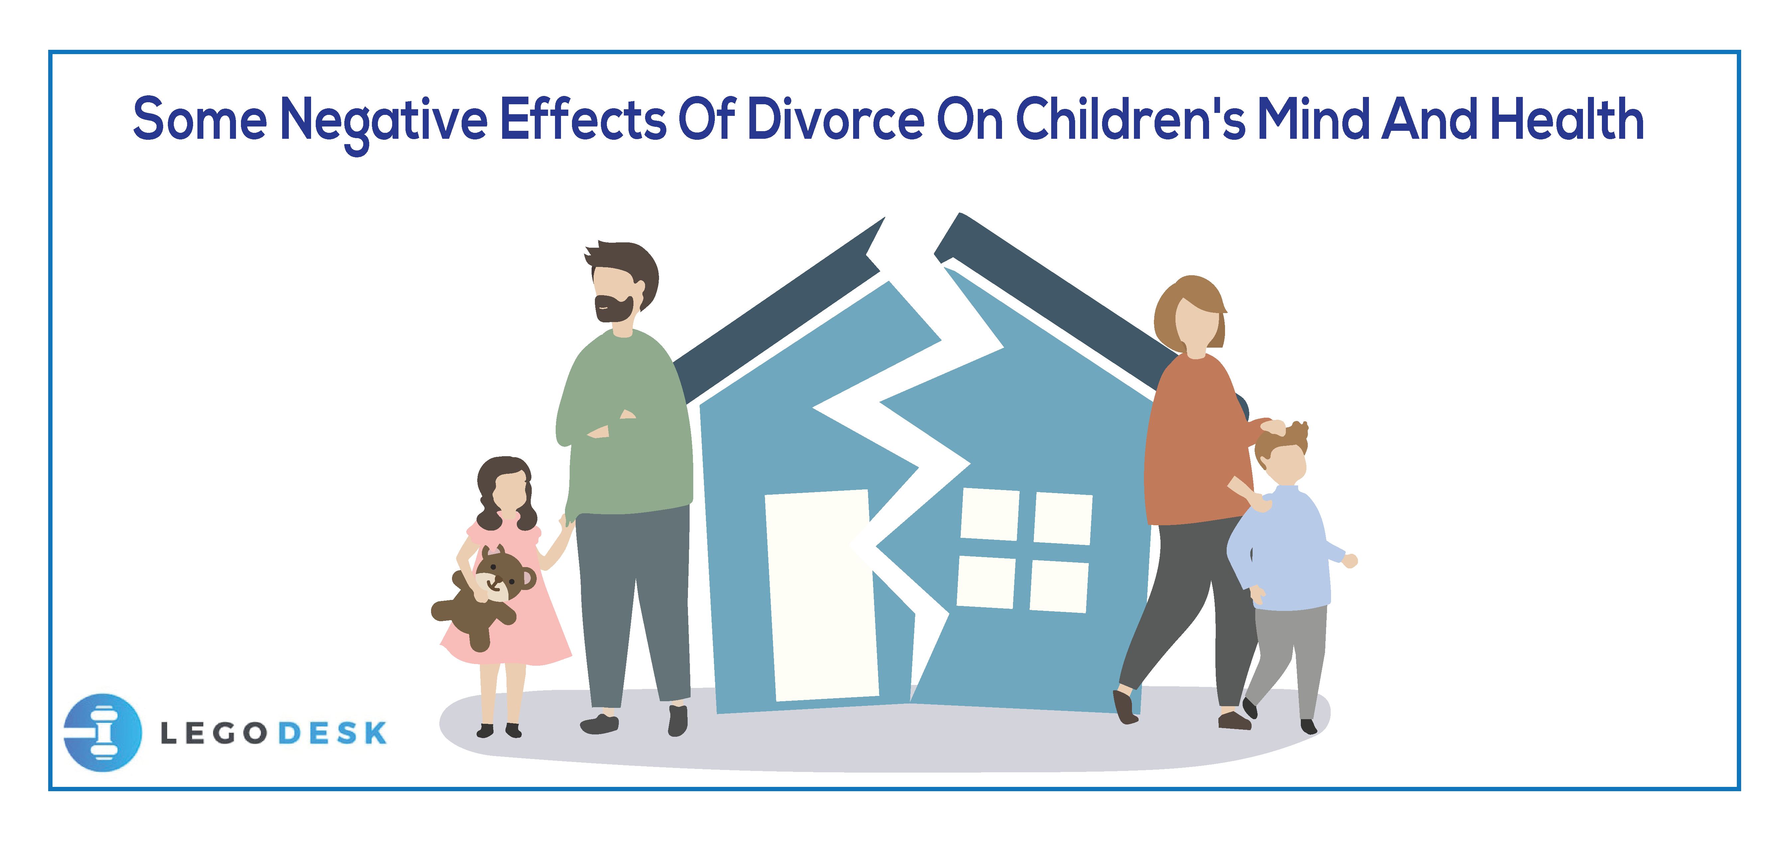
Negative effects of divorce
Negative Effects Divorce takes a toll on children’s well-being. Children whose parents divorce are more likely than children reared by both parents to have behavioral problems, to get poor grades and drop out of high school, and to get in trouble with the law (Amato 2000, 2010).

Slide 18

What Helps Children Adjust to Divorce?
The children who feel close to both parents make the best adjustment, and those who don’t feel close to either parent make the worst adjustment (Richardson and McCabe 2001)
Children have an especially difficult time when one parent tries to undermine the other. These children are more likely to be depressed and insecure—even after they are grown up (Ben-Ami and Baker 2012).
Children adjust well if they experience little conflict, feel loved, live with a parent who is making a good adjustment, and have consistent routines.
Children also adjust better if a second adult can be counted on for support

Slide 19
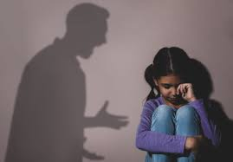

The dark side of family
Domestic violence
Incest
Child Abuse

Slide 20

The Bright Side of Family Life: Successful Marriages
Successful Marriages Sociologists Jeanette and Robert Lauer (1992) interviewed 351 couples who had been married fifteen years or longer. Fifty-one of these marriages were unhappy. The couples had stayed together for religious reasons, because of family tradition, or “for the sake of the children.”
Happy couples :
1. Consider their spouse to be their best friend, like their spouse as a person
2. Think of marriage as a long-term commitment. Believe that marriage is sacred
3. Agree on aims and goals
4. Believe that their spouse has grown more interesting over the years
5. Strongly want the relationship to succeed. Laugh together

Slide 21
The Bright Side of Family Life: Successful Marriages
Sociologist Nicholas Stinnett (1992) studied 660 families from the United States and
South America. He found that the happy families
1. Spend a lot of time together
2. Are quick to express appreciation
3. Promote one another’s welfare
4. Do a lot of talking and listen to one another
5. Are religious
6. Deal with crises in a positive manner

Slide 22


The Future of Marriage and Family
Its universal so it will not collapse as an institute
More decision making power will be own by the females in coming times.

Slide 23


